Slide 1

COMS 3009/28A Software Design
Requirements
University of the Witwatersrand, Johannesburg
School of Computer Science and Applied Mathematics
Lucky Nkosi

Slide 2
What is a software requirement?

Slide 3

What is a Software Requirement?
A requirement specifies the business functions that the user will be able to perform using the system-to-be in different “situations” or “contexts”, and the kind of experience the user will have during this work
May include concerns, such as how the system will manage the resources (computing, network,...), how the system will manage and protect user’s data, etc.

Slide 4
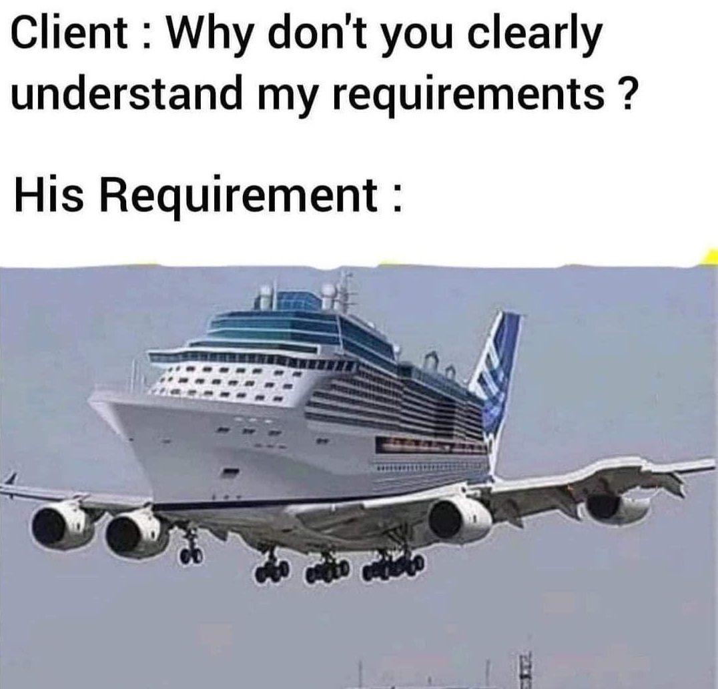

Slide 5

Software Requirements
User requirements will often be high-level, vague and incomplete. They are more like high-level goals, or business goals, rather than software requirements needed by the developer
Software engineer’s job to translate requirements into something useful
How do we bridge the gap?
Notes:
The question is how do we bridge the gap between the two things?
By considering the following

Slide 6
Vague to technical requirements
Ask: What matters? What are the important considerations?
Features
Security
Data Sovereignty
Availability and Reliability?
User Personas
Notes:
Ask: what matters?

Slide 7
Understanding what matters
helps us understand “scenarios” or “situations” we need to cater for and relevant parameters (system inputs).
Understanding scenarios and their parameters help us decide what the system should do or respond to the situation.
Eg: ATM user needs to be Authenticated with parameters being a card and pin.
Situation is Authentication and parameters are the card and pin
This understanding is unpacked into tasks.

Slide 8
Understanding what matters is called Requirements Engineering

Slide 9
Types of Requirements
Functional requirements: Product features/ features essential to user’s task completion
Non-functional requirements (AKA Quality requirements)
Usability (ease of use, efficiency, learning curve, etc)
Security (encryption, protection from viruses/malware, privacy, etc. )
Reliability (bug-free, not crashing, no hardware failures, etc.)
Performance (load times, CPU usage, etc.)
Availability (minimising the impact of maintenance/ downtime)
Scalability (handling more users, more data, more operations, etc.)
User Interface (UI): On-screen appearance requirements (look & feel)

Slide 10
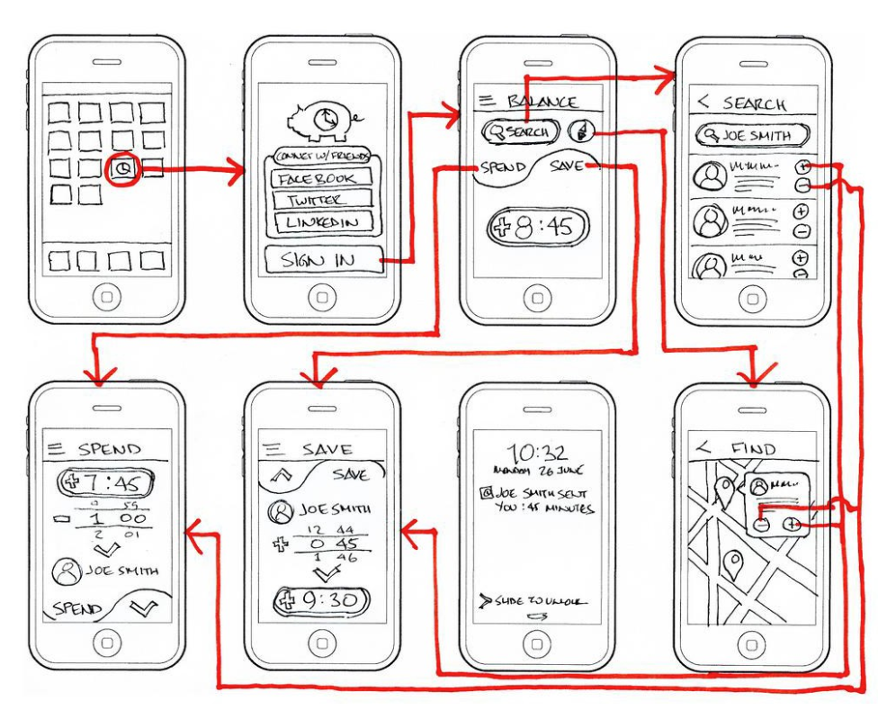
UI Requirements are high level
Do not waste your time with minor details
Focus on the important aspects of the interface
Hand-drawing the proposed interface forces you to economize and focus on the most important features

Slide 11
UI artefacts/outputs
There are 3 types of artefacts we can produce at for UI requirements gathering:
Wireframes
Mockups
Prototypes

Slide 12
UI Artefacts
 | Wireframe | Mockup | Prototype
What | A quick sketch to convey the high-level concept of new product functionality | A realistic visual design that resembles what the new product functionality will look like | Interactive simulation of new product functionality
Purpose | To gain consensus and collect internal feedback on how new functionality will work | To facilitate more detailed critiques of visual elements and functionality so changes can be made | To collect feedback by user testing the real experience
Design fidelity | Low | Middle | High
Included elements | The format and structure of content | Additional visual elements like logos, colors, and icons | Final interactive elements and navigation
Time invested | Low | Medium | High
Creator | PM or UX Designer | UX Designer | UX Designer
Notes:
Wireframes are great at high level stage of requirement gathering

Slide 13
Requirements Engineering
Requirements Gathering
Helps the customer to define what is required: what is to be accomplished, how the system will fit into the needs of the business, and how the system will be used on a day-to-day basis
Requirements Analysis
Refining and modifying the gathered requirements
Not necessarily sequential – some back and forth between devs and client
Requirements Specification
Documenting the system requirements in a semi-formal or formal manner to ensure clarity, consistency, and completeness
e.g. User stories, UML diagrams, acceptance tests, etc.
Ensures traceability

Slide 14
How do we gather & express these requirements?
Notes:
Use cases and stories

Slide 15
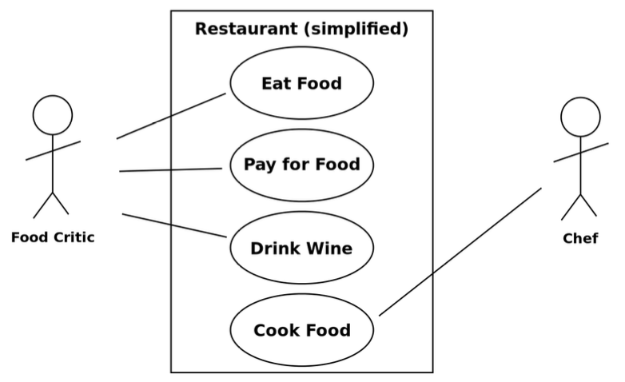
Use Cases
A use case is a list of actions or event steps typically defining the interactions between a role and a system to achieve a goal
Represented in UML with use case diagrams
Ovals = use cases
Stick figures = actors
Boxes = system boundary
Lines = associations

Slide 16
Example Requirements (home Security)
Identifier | Priority | Requirement
REQ1 | 5 | The system shall keep the door locked at all times, unless commanded otherwise by authorized user. When the lock is disarmed, a countdown shall be initiated at the end of which the lock shall be automatically armed (if still disarmed).
REQ2 | 2 | The system shall lock the door when commanded by pressing a dedicated button.
REQ3 | 5 | The system shall, given a valid key code, unlock the door and activate other devices.
REQ4 | 4 | The system should allow mistakes while entering the key code. However, to resist “dictionary attacks,” the number of allowed failed attempts shall be small, say three, after which the system will block and the alarm bell shall be sounded.
REQ5 | 2 | The system shall maintain a history log of all attempted accesses for later review.
REQ6 | 2 | The system should allow adding new authorized persons at runtime or removing existing ones.
REQ7 | 2 | The system shall allow configuring the preferences for device activation when the user provides a valid key code, as well as when a burglary attempt is detected.
REQ8 | 1 | The system should allow searching the history log by specifying one or more of these parameters: the time frame, the actor role, the door location, or the event type (unlock, lock, power failure, etc.). This function shall be available over the Web by pointing a browser to a specified URL.
REQ9 | 1 | The system should allow filing inquiries about “suspicious” accesses. This function shall be available over the Web.

Slide 17
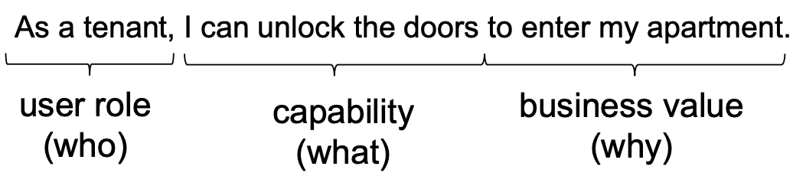
User stories
Who-What-Why
Focus on user benefits rather than system benefits
Must have one or more acceptance tests attached (Test-Driven Development)
Preferred tool in agile methodology

Slide 18
How do we know that a requirement has been met?

Slide 19
Acceptance testing

Slide 20
What is an Acceptance Test?
An acceptance test case specifies, for a given “situation” or “context” (defined by current system inputs), the output or behavior the system will produce in response
User Acceptance Test – Works for user (user focused)
Operational Acceptance Test – operational readiness (system focused)
Notes:
Acceptance test cases specify, for a situation, the output or behaviour the system will produce. ” when something happens, the system will do x,y,z”
UAT - ” when a user clicks button A, a popup appears”
OAT – Includes, operational concerns like scalability

Slide 21
Acceptance Testing
Acceptance tests are a means of assessing that the requirements are met as expected
May be conducted by the client Describe whether the system will pass or fail a test given specific input values
Cannot ever guarantee 100% coverage of all usage scenarios, but systematic approach can increase the degree of coverage

Slide 22
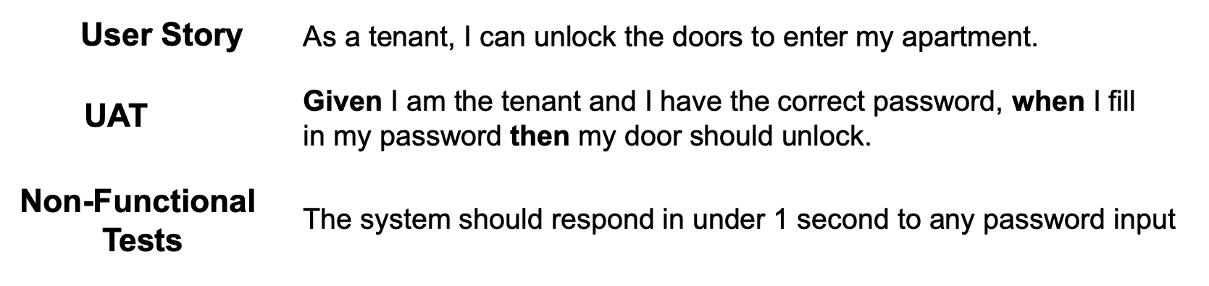
User Acceptance Test
Verifies that the software solution works for the user
Given-When-Then

Slide 23
Example User Stories (Home security)
Identifier | User Story | Size
ST-1 | As an authorized person (tenant or landlord), I can keep the doors locked at all times, so that .... | 4 points
ST-2 | As an authorized person (tenant or landlord), I can lock the doors on demand, so that .... | 3 pts
ST-3 | The lock should be automatically locked after a defined period of time, so that .... | 6 pts
ST-4 | As an authorized person (tenant or landlord), I can unlock the doors, so that .... (Test: Allow a small number of mistakes, say three.) | 9 points
ST-5 | As a landlord, I can at runtime manage authorized persons, so that .... | 10 pts
ST-6 | As an authorized person (tenant or landlord), I can view past accesses, so that .... | 6 pts
ST-7 | As a tenant, I can configure the preferences for activation of various devices, so that .... | 6 pts
ST-8 | As a tenant, I can file complaint about “suspicious” accesses, so that .... | 6 pts
Notes:
Use cases focus on the system at hand and user stories focus on how the user would use the system

Slide 24
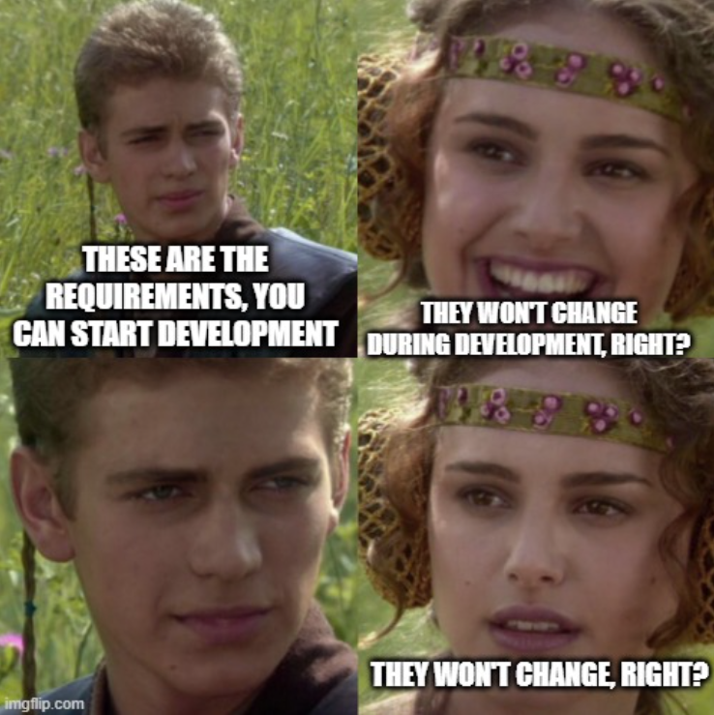
Requirements Analysis
Requirements should be
Documented – recorded for future use
Traceable – who said what, which meeting, when was this designed, etc.
Actionable – break requirements into tasks that can be implemented
Testable – acceptance tests
Related to business needs – user stories (who-what-why)

Slide 25
Requirements Analysis
Refinement of client requirements
Need to evaluate feasibility and realism
Need to explicitly identify business policies (business rules)
Helps involve client and other stakeholders in designing a solution
Helps anticipate future changes in policy so that mechanisms can be implemented that future-proof code and allow for quick substitutions of policy
Helps identify and elicit further requirements

Slide 26
Requirements Analysis: Sprint Planning Meeting
1st Half:
Whole team (devs and product owner) select product backlog items that they believe can be completed during the sprint
2nd Half
Devs break each item into tasks (actionable) required to complete those items
Tasks may include architecture, design, coding, testing, infrastructure, deployment, documentation, etc.

Slide 27
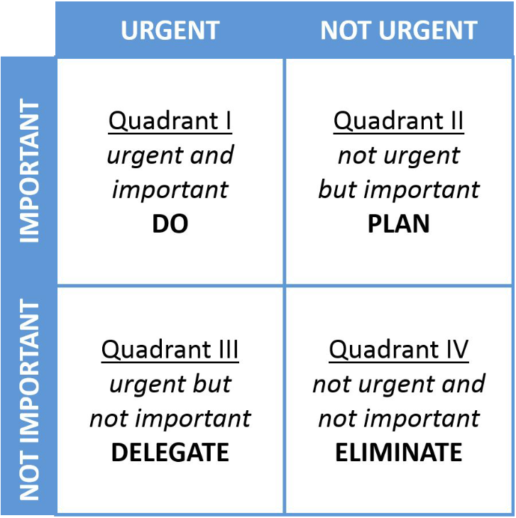
Requirements Prioritisation
Requirements prioritisation can be difficult
There is a difference between “urgent” and “important”
Can be difficult to assign “priority points” to requirements
Often easier to do a rank ordering

Slide 28
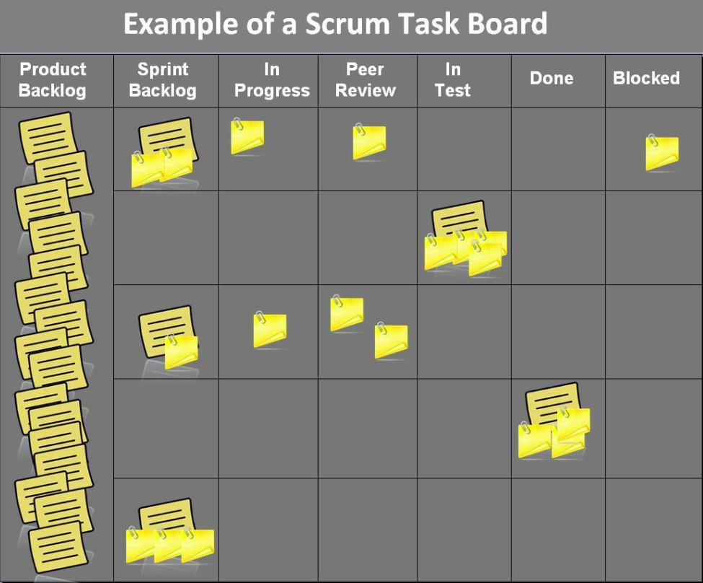
Requirements Prioritisation

Slide 29

How do we know how long it will take us?

Slide 30
Requirements Sizing
Identifier | User Story | Size
ST-1 | As an authorized person (tenant or landlord), I can keep the doors locked at all times, so that .... | 4 points
ST-2 | As an authorized person (tenant or landlord), I can lock the doors on demand, so that .... | 3 pts
ST-3 | The lock should be automatically locked after a defined period of time, so that .... | 6 pts
ST-4 | As an authorized person (tenant or landlord), I can unlock the doors, so that .... (Test: Allow a small number of mistakes, say three.) | 9 points
ST-5 | As a landlord, I can at runtime manage authorized persons, so that .... | 10 pts
ST-6 | As an authorized person (tenant or landlord), I can view past accesses, so that .... | 6 pts
ST-7 | As a tenant, I can configure the preferences for activation of various devices, so that .... | 6 pts
ST-8 | As a tenant, I can file complaint about “suspicious” accesses, so that .... | 6 pts
Often a need to work out which user stories and tasks require the most effort
Estimated using size points: each user story is assigned a number of points based on its size

Slide 31
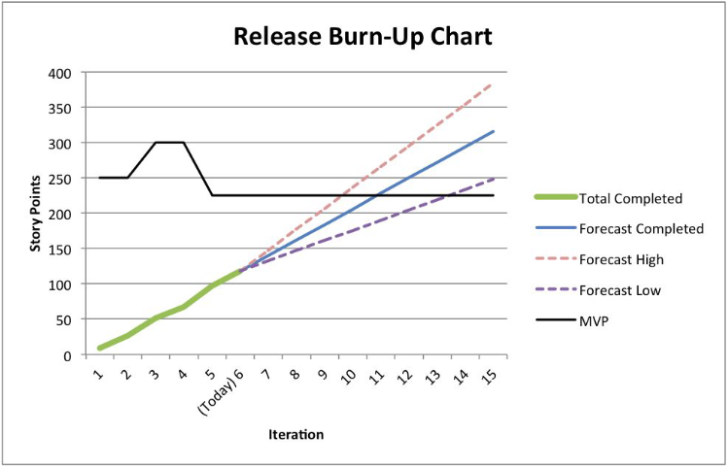

Requirements Sizing
Total project size = sum of all user story points
Velocity (burn rate) is estimated by looking at number of points completed per day
$$Project duration = \frac{Total Size}{Velocity}$$

Slide 32
Tools for Requirements Specification
Software Tools
GitHub Projects
Monday
Trello
Taiga
Azure Devops
Notion
Kanboard

Slide 33
Done for today

